Slide 1


Behavioural Analysis of Students
Vivekanand Education Society’s Institute of Technology, Computer Department
Team name: Innoventors
Team members:Anushka Tiwari (D17A)
Divya Manoj (D17C)
Raj Mendon (D17B)
06 March 2020

Slide 2
Abstract.
We attempt to predict the behaviour and hence the mental state of the student by giving them a scenario based questionnaire and taking their answers in form of text. This text is then analyzed using NLP. A set of keywords which determine mental state and behavior of student are detected. The behaviour of student is then classified using supervised machine learning algorithm. Once this is done, it can be further analyzed and used for no. of applications like emotional difficulty tackling, changes in class management strategies, comparison with students of other institution, satisfaction of the student with the curriculum and the overall image of the institution in their mind.
06 March 2020

Slide 3
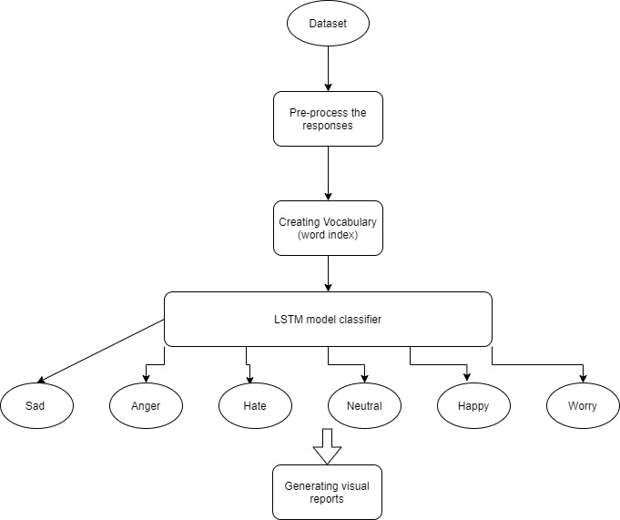
Proposed Architecture/Diagram
06 March 2020

Slide 4
Technology Stack
Back-end technologies used -
Programming language : Python
Libraries used : Keras, numpy, pandas, matplotlib, NLTK
Machine Learning algorithms used: Deep Learning using LSTM
Front-end technologies used -
HTML, CSS, Javascript, Google Forms
06 March 2020

Slide 5
Conclusion
Hence, we plan to use NLP and machine learning for the prediction of student behaviour and further analyse it for student satisfaction with the curriculum and institution and dropout prediction.

